Slide 1
Psychopathology
Session 6- Cultural Considerations

Slide 2
Clinical Interview Practice
Groups of 3
One Therapist, One Client, Others are observers
Truly role play therapist conducting clinical interview
About 7-10 minutes
Explore Multiple Domains- history, present experience, thoughts, feelings, physical. Ask about suicidal ideation. Ask about culture if appropriate.
Do not jump to a diagnosis, practice exploring to confirm.
Observers can provide feedback after the “session”

Slide 3
Clinical Interview Practice Continued
Use open and closed questions to explore symptoms
CONFRIM experience do not speculate
Verify- intensity, frequency, duration, impact (clinical significance), insight, awareness,
Remember the steps of differential diagnosis
Malingering/factitious, substances, medical, diagnosis, adjustment, no disorder
Focus on the questions you will need to ask to get the information needed.
What do I need to know and what question will get the information I need

Slide 4
Schizophrenia
Key Features- Positive Symptoms
Delusions
Hallucinations
Disorganized Thinking and Speech
Disorganized or Abnormal Behavior
Castonguay, Oltmanns, & Lott 2021

Slide 5
Schizophrenia
Key Features- Negative Symptoms
Asociality- decreased interest in close relationships
Avolition- Reduced motivation or persistence for everyday activities
Blunted Affect- lack of outward expression
Alogia- Limited speech
Castonguay , Oltmanns, & Lott 2021

Slide 6
Schizophrenia Disorders
Delusional Disorder
One or more delusions for a month or longer but Criteria A for schizophrenia has not been met
Brief Psychotic Disorder
Experience one of the primary symptoms of schizophrenia for at least a day but less than a month
Onset is sudden
Schizophreniform Disorder
Same expression of Schizophrenia but does not meet duration
APA, 2022

Slide 7
Schizophrenia Disorders
Schizoaffective Disorder
Meets criteria A for Schizophrenia, but includes a mood disorder for the duration of the psychotic episode
Depression must be pervasive as low mood and disengagement is common in Schizophrenia.
APA, 2022

Slide 8
Somatic Symptom Related Disorders
Primary Feature of Distress From Somatic Symptoms
More Common in Medical Settings
May come by referral
Includes
Somatic Symptom Disorder,
Illness Anxiety Disorder,
Functional Neurological Symptom Disorder (Conversion Disorder,0
Factitious Disorder, and
Psychological Factors Affecting Medical Conditions
(APA, 2022

Slide 9
Somatic Symptom Disorder
Distress from one or more somatic complaint
Pain is common, can be specific or general complaint
Not related to medical condition
Can occur in conjunction with medical diagnosis
Suffering is real even without a medical cause
Significant/excessive worry about somatic experience
Misattribution of typical experience to be something more serious
Actions taken to seek reassurance and get help
(APA, 2022)

Slide 10
Illness Anxiety Disorder
Concern about having or acquiring a condition
Typically no experience of symptoms, mild if present
If a medical condition is present, the distress is beyond typical experience.
How is this differentiated from SSD?
(APA, 2022)

Slide 11
Functional Neurological Symptom Disorder (Conversion Disorder)
Motor or Sensory symptoms without identifiable physical cause
Must be clear evidence the symptom is not a result of a neurological issue
Onset may be related to stress or trauma
Often incudes dissociative experiences
(APA, 2022)

Slide 12
Culture
What is Culture?
Behavioral norms, meanings, values and more
DSM
Knowledge, rules and practices
Includes language religion, spirituality and family structures
Cultural Psychiatry
Using the lens of culture to define psychopathology
Be cautions to include all cultures- Majority and Minority
Alarcon, 2009

Slide 13
Our Task As Clinicians
Identify pathogenic triggers
War, poverty, values, practices
Attitudes toward/barriers to seeking help
Understand cultural influences
Micro-Culture- Family
Roles, hierarchies, practices, values
Macro-culture/Macro-environment
Media, socio-political, public behavior
Alarcon, 2009

Slide 14
Our Task As Clinicians
Identify pathoplastic factors (symptom expression)
Terminology and definitions
Context for the narrative – client/therapist interaction
Power differential, saving face, preservation of image
Cultural explanation for how and why illness occurs
Biological vs. spiritual causes
Generational transmission
Alarcon, 2009

Slide 15
Impact of Ethnic Identity
Acculturation
Identification with home culture & host culture
Stages- Ambivalence, ethnic exploration, multicultural acceptance
Impact of solid cultural identity
Higher ethnic identity = higher self-esteem & protective factors
Impact of acculturations difficulties
Higher rate of expressed pathology
Chapman, Delapp, & Williams , 2014

Slide 16
Adjust Approach
How do we incorporate culture into assessment and diagnosis?
Approach diagnosis with multicultural lens
Not ethnocentric
Ask relevant questions of client and self
What is the client’s perspective?
How is my culture influencing how I see this client’s pathology?

Slide 17
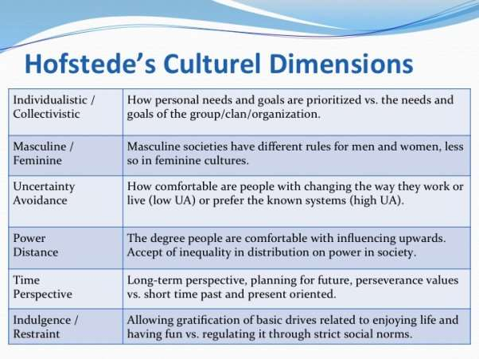
Resources
Hofstede Indices
Compare cultures on various dimensions
How we interact, worldview, power dynamics

Slide 18
Resources
Ethnomed.org
Explore history, culture, health perspectives
Not exhaustive but a good start
DSM 5 Cultural Interview

